Slide 1
Need to build a NodeOrders DB and asp api server and client app for loading data
You should have done this already
So this part is the HW
Probably want to stick with my names, as later, I will give you useful SQL scripts. But you can use your own names, and then edit my scripts to match.
I was inconsistent about starting all these names with a capital letter, please catch my mistakes and start all these names with a capital letter.

Slide 2
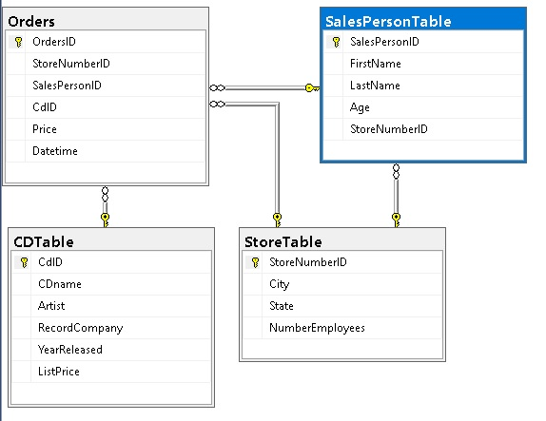
Step 1
(see my scripts)
Our Database, with keys and relationships:
Build and save scripts to create these tables so that
when things are quite right, you can easily start again.

Slide 3
Please use these table and column names FOR YOUR CODE, they match the script I gave you to build the NodeOrders database. DO use the script to build the SQL tables
CDTable
[CdID] [int] IDENTITY(1,1)
[CDname] [nvarchar](50)
[Artist] [nvarchar](50)
[RecordCompany] [nvarchar](50)
[YearReleased] [int]
[ListPrice] [money]
Orders
[OrdersID] [int] IDENTITY(1,1)
[StoreNumberID] [int]
[SalesPersonID] [int]
[CdID] [int]
[Price] [int]
[Datetime] [datetime]
SalesPersonTable
[SalesPersonID] [int] IDENTITY(1,1)
[FirstName] [nvarchar](50)
[LastName] [nvarchar](50)
[Age] [int]
[StoreNumberID] [int]
StoreTable
[StoreNumberID] [int] IDENTITY(1,1)
[City] [nvarchar](50)
[State] [nvarchar](50)
[NumberEmployees]

Slide 4
Step 2
Create an ASP.NET Web Application (.Net Framework) , then select Web API
Delete the auto created Controller(s)
Add “new” “data” ADO.NET Entity Data Model
name it NodeOrdersModel
Select EF Designer from data… (base)
Connect to your NodeOrders database
Expand the objects viewer and select only CDTable, Orders, SalesPersonTable, and StoreTable
After it draws your diagram, make sure to click save
As you look at the diagram, note the “navigation properties” remember or review or learn how they work.

Slide 5
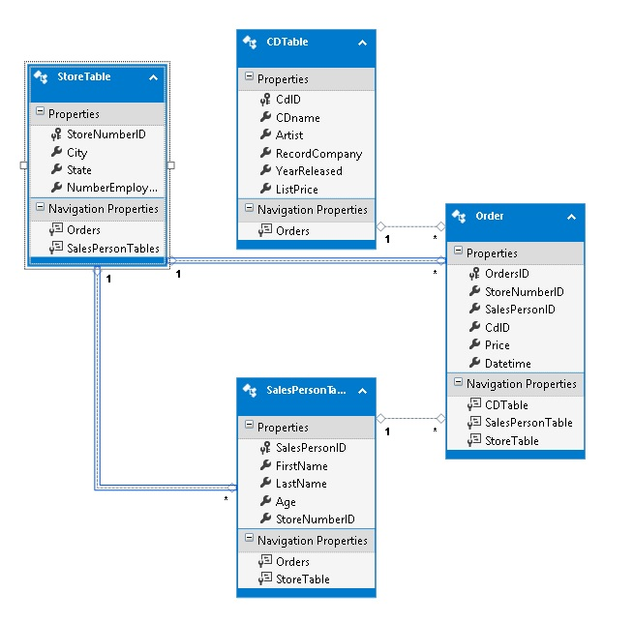
Your autocreated model diagram should contain these 4 entities and relationships.

Slide 6
The next steps will be to add
4 controllers
HTML/Javascipt
So user can add to, and see contents of all 4 tables from the database == all 4 entities in the Entity Model
You can put all the HTML on one page, even though it will be a bit messy, or you can make 4 pages with button links if you want.

Slide 7
Step 3
Add a Web API 2 Controller – Empty name it CDController
Instantiate your Entities, if you used my naming, it will be
NodeOrdersEntities myEntities = new NodeOrdersEntities();
Add 2 methods than allows adding a new CD into the CDTable and another method to return all CDs.
Build a corresponding html/javasript app that allows user to submit a new CD
CDname
Artist
RecordCompany
YearReleased
ListPrice
Make up 3 CDs and enter them into the table
Your html page should display all the CDs in your table.
These 2 methods and the html/javascript code should be a direct clone of the Notes project we did in class on Feb 6th.
Do not spend time making fancy HTML, as we are going to replace the HTML later with jQuery Mobile.

Slide 8
Step 4
Repeat Step 3 with a new controller and added html/javascript so that a user can add a new store to StoreTable.
Should have input for
City
State
NumberEmployees
Enter 3 made up stores
Html page should show all existing stores

Slide 9
Step 5
Repeat so that user can add a new employee to SalesPersonTable.
Should have input for
FirstName
LastName
Age
StoreNumberID (must be a drop down box or some other selectable tool, showing all the stores in the StoreTable. )
Enter 6 made up employees, 2 for each store
HTML should show all the employees in the database

Slide 10
Step 6
Repeat so that user can add a new order to Orders.
Should have input for
StoreNumberID (must be a drop down box or some other selectable tool, filled with data from the StoreTable)
SalesPersonID (must be a drop down box or some other selectable tool, filled with data from the SalesPersonTable)
CdID (must be a drop down box or some other selectable tool, filled with data from the CDTable)
Price
(Datetime should be auto created by your code)
Enter 5 made up orders
Html should show all the orders in the database

